Slide 1



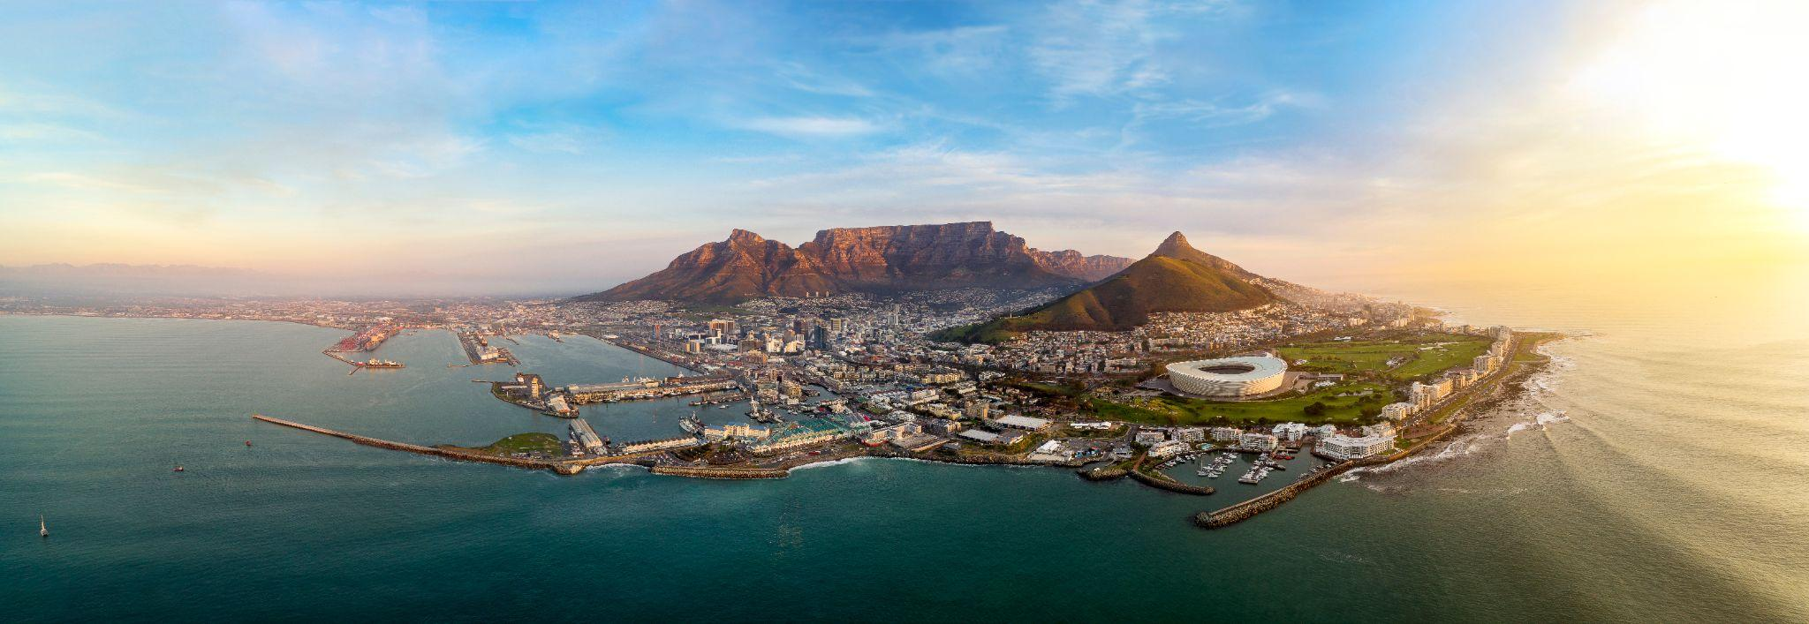
(Insert your topic/title presentation here)
First Name & Last Name
Institution/University

Slide 2

Conflict of interest
I have no conflict of interest to declare
I have the following conflict of interest to declare
20th International Congress on Infectious Diseases (ICID)
3-6 December 2024, Cape Town, South Africa

Slide 3
20th International Congress on Infectious Diseases (ICID)
3-6 December 2024, Cape Town, South Africa

Slide 4
20th International Congress on Infectious Diseases (ICID)
3-6 December 2024, Cape Town, South Africa

Slide 5
20th International Congress on Infectious Diseases (ICID)
3-6 December 2024, Cape Town, South Africa

Slide 6
20th International Congress on Infectious Diseases (ICID)
3-6 December 2024, Cape Town, South Africa

Slide 7
20th International Congress on Infectious Diseases (ICID)
3-6 December 2024, Cape Town, South Africa

Slide 8
20th International Congress on Infectious Diseases (ICID)
3-6 December 2024, Cape Town, South Africa

Slide 9
20th International Congress on Infectious Diseases (ICID)
3-6 December 2024, Cape Town, South Africa

Slide 10
20th International Congress on Infectious Diseases (ICID)
3-6 December 2024, Cape Town, South Africa

Slide 11
20th International Congress on Infectious Diseases (ICID)
3-6 December 2024, Cape Town, South Africa

Slide 12
20th International Congress on Infectious Diseases (ICID)
3-6 December 2024, Cape Town, South Africa

